Slide 1
MANAGEMENT OF ASTHMA
Dr Dabbaghzadeh
Allergist And Clinical Immunologist

Slide 2
To the child and parent, the relevant definition most frequently cited is symptom control, whereas to the clinician, the most important feature is disease control.
Ideally, a medication should satisfy both criteria simultaneously.

Slide 3
NAEPP, EPR-3 states that attaining and sustaining asthma control requires four components of care:
(1) Assessment and monitoring
(2) Education for a partnership in care
(3) Control of environmental factors and comorbid conditions that may trigger asthma
(4) Pharmacologic therapy.

Slide 4
NAEPP, EPR-3 states that attaining and sustaining asthma control requires four components of care:
Asthma severity is defined as the intrinsic intensity of the disease process and is most easily assessed in a child who is not currently on long-term controller therapy
Severity also can be measured after asthma control is achieved by the amount of medication required to sustain asthma control.
Asthma control is described as the degree to which the symptoms of asthma are alleviated by treatment and the goals of therapy are met.
Severity at initial evaluation should be used to guide treatment choices.
The level of asthma control is used to adjust therapy

Slide 5
The EPR-3 designates four categories of severity:
Intermittent
Mild persistent
Moderate persistent
Severe persistent

Slide 6
The EPR-3 divides control into three categories:
Well-controlled
Not well-controlled
Very poorly controlled

Slide 7
Asthma severity and asthma control are evaluated in the context of two domains: impairment (current asthma symptom burden and pulmonary function) and risk (future asthma morbidity in terms of exacerbations and side effects from medications):
Impairment domain goals
• Prevent chronic and troublesome symptoms
Prevent recurrent exacerbations minimize the ED visits or hospitalizations
• Require infrequent use (≤2 d/w) SABA for quick relief of symptoms
• Maintain (near) normal lung function
• Maintain normal activity levels
• Meet patient and family expectations
• Prevent loss of lung function; for children, prevent reduced lung growth
• Minimal or no adverse effects of therapy
Risk domain goals

Slide 8
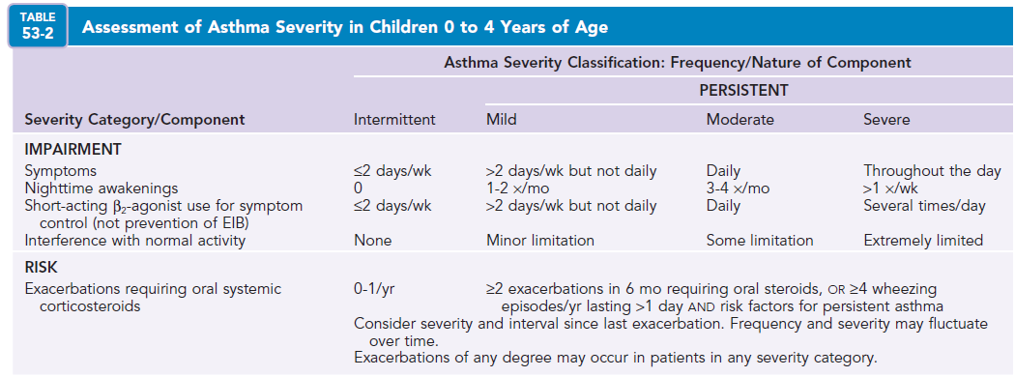

Slide 10
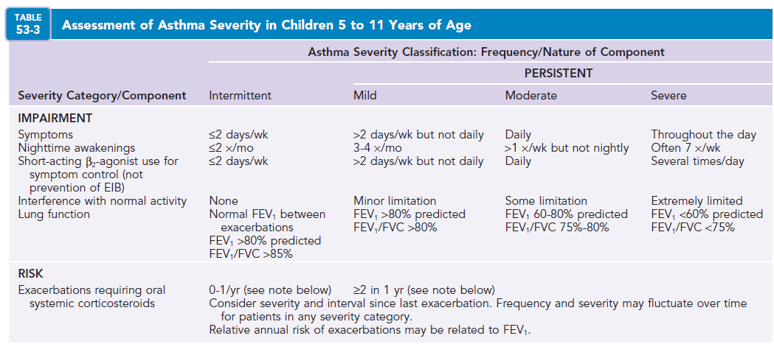

Slide 11
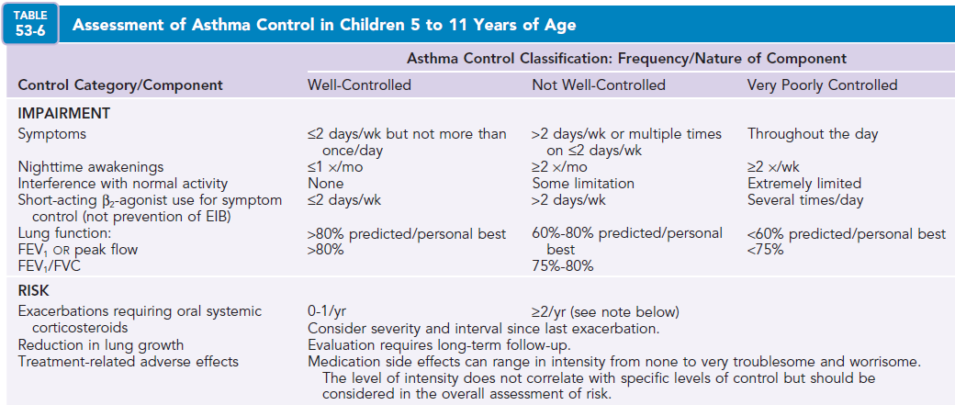

Slide 12
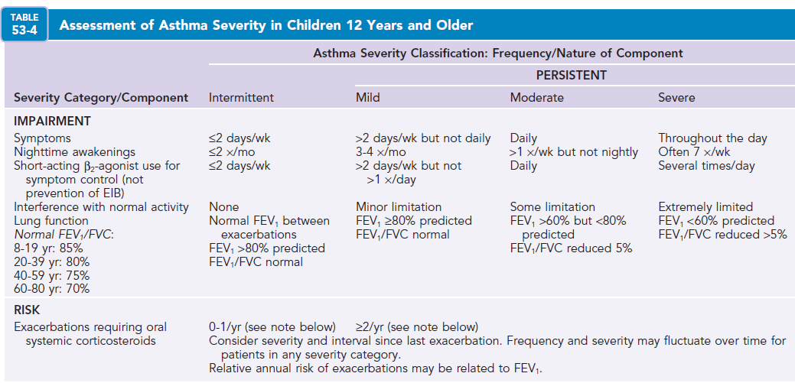

Slide 13
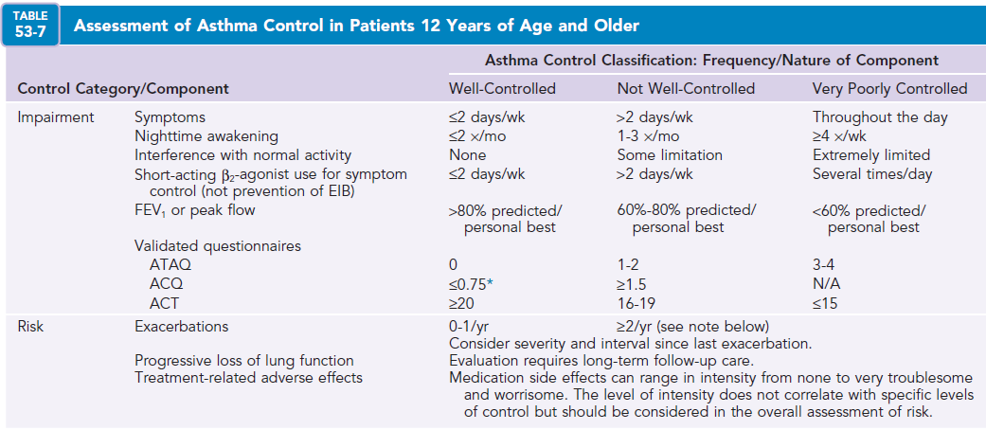

Slide 14
Chronic Asthma Management
Pharmacologic therapy

Slide 15
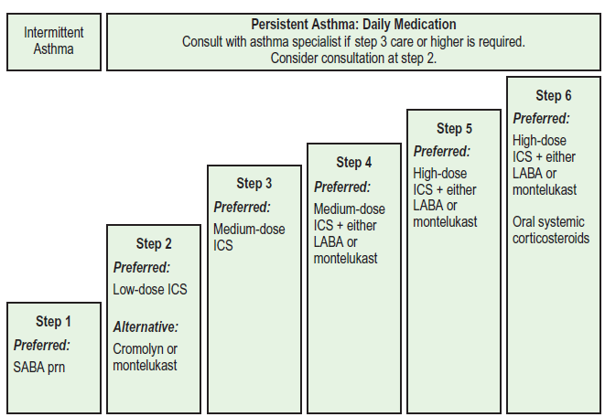
0-4 year

Slide 16
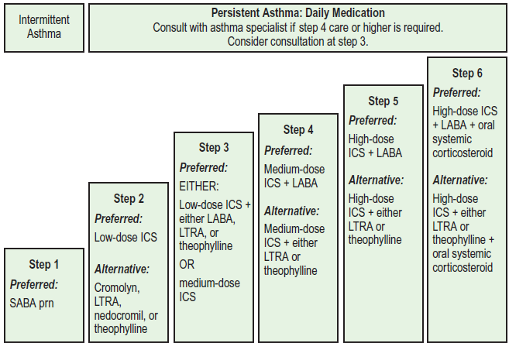
5-11 year

Slide 17
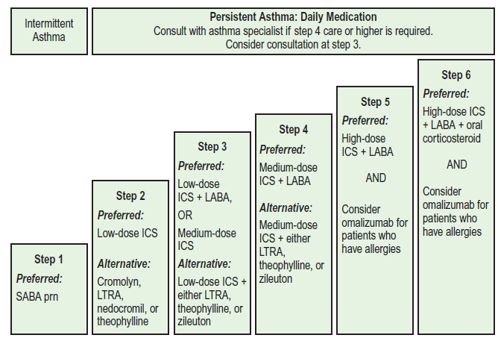
>12 year

Slide 18
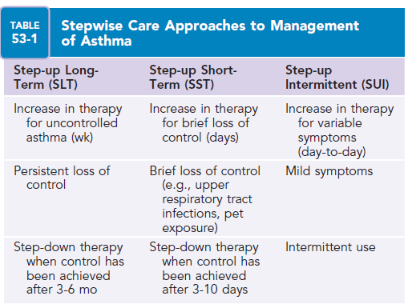

Slide 19
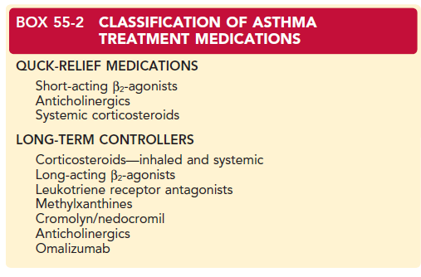

Slide 20
RECOMMENDATIONS
• Be aware of the devices that are available to deliver specific drugs and classes of drugs .
• Know the advantages and disadvantages of each device.
• Choose devices that the patient can and will use effectively.
• Choose devices that have been approved by the appropriate authorities.
• Train patients about the correct inhalation maneuver that is appropriate for the device being prescribed.
• Check your patient’s inhaler technique regularly.
• Review the patient’s adherence to treatment at each visit.
• Do not switch to a new device without the patient’s involvement and without follow-up education on how to use the device properly.

Slide 21
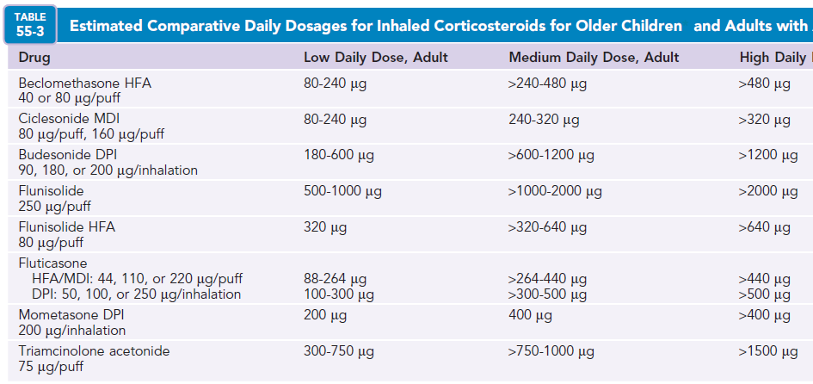

Slide 22
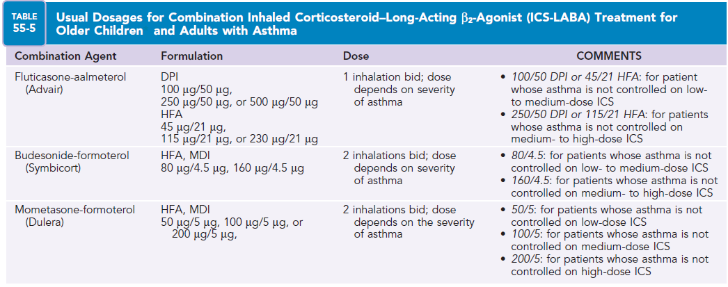

Slide 23
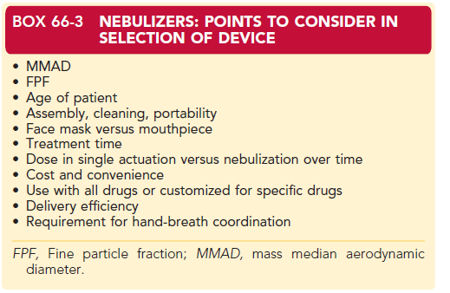

Slide 24
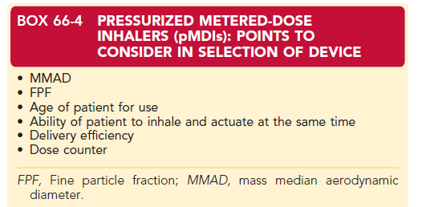

Slide 26
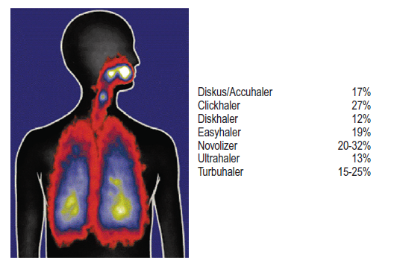
Percent lung deposition for most commonly used dry powder inhalers

Slide 27
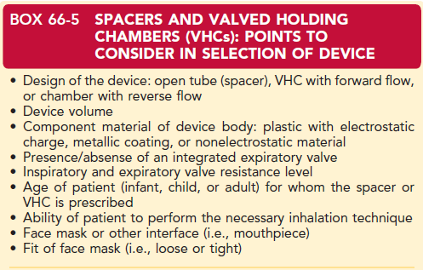

Slide 28
Aerosol delivery devices
Aerosol delivery devices for treating asthma and COPD have changed dramatically in the last 30 years.
This has been the result of an expanding role for aerosolized drugs.
For a number of years, there has been a growing interest in using aerosolized drugs for gene therapy to treat cystic fibrosis, for vaccines to prevent measles, for proteins to treat systemic disorders, for cyclosporine to treat lung transplant recipients, and for vasodilators to treat pulmonary hypertension.

Slide 29
Aerosol delivery devices
For aerosol delivery to succeed with these newer, more expensive applications, however, the inhalation devices needed to deliver a high percentage of the dose to the lungs, and existing devices such as traditional jet nebulizers and pressurized metered-dose inhalers (pMDIs) could not meet those requirements.
Aerosol delivery devices have changed as a result of the Montreal Protocol, which was ratified in 1989.
The Montreal Protocol called for the elimination of chlorofluorocarbons (CFCs) in pMDIs as a response to the depletion of the earth’s ozone layer by CFCs.

Slide 30
Aerosol delivery devices
Taken together, the need for more efficient devices for delivering expensive new drugs and the need to eliminate CFCs in pMDIs provided the impetus to develop alternative, non–propellant-dependent aerosol delivery systems.
As a result, in the last 15 to 20 years, major design changes have occurred in all three categories of aerosol drug delivery devices—pMDIs, dry powder inhalers (DPIs), and nebulizers— giving the patient innovative inhalers with increased lung deposition, along with improved control of aerosol production and inhalation flow rates.

Slide 31
Aerosol delivery devices
The innovation of DPIs has eliminated the need for the actuation-inhalation coordination that is required for pMDI drug delivery.
The introduction of hydrofluoroalkane (HFA) as an alternative propellant for pMDIs has led to the availability of low-velocity propellant-driven aerosols.
New-generation nebulizers have been developed that are portable and extremely efficient.
Other newer nebulizers are considered “smart” inhalers in that they incorporate features that limit the patient’s breathing rate. These innovations may improve drug delivery to the lungs.

Slide 32
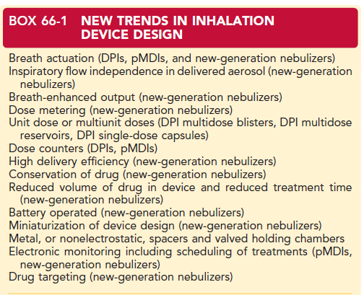

Slide 33
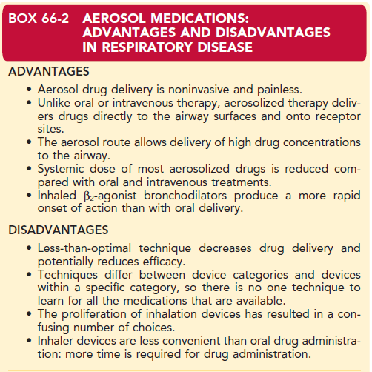

Slide 34
Factors That Affect Aerosol Deposition
physical factors such as particle diameter and the FPF of the aerosol. Changes to the physical quality of the aerosol effected through alterations in either formulation or design (hardware), or the use of baffles or spacers, reflected in changes to the emitted dose (ED), FPF, and fine particle dose (FPD);
ventilatory factors such as inspiratory volume, inspiratory flow rate, breath-hold time, breathing rate, and nose versus mouth breathing;
anatomic factors such as airway caliber and distortion due to disease; and
patientrelated factors such as the ability to correctly use the delivery system and compliance.

Slide 35
The size of an aerosol particle is the primary determinant of the site of lung deposition, distribution of the drug within the lung, and resulting deposition efficiency.8 Sizes for environmental and occupational aerosols range from 0.001 μm in diameter, termed nanoparticles, to 1000 μm in diameter, termed supercoarse.
Therapeutic aerosols targeted to the lower respiratory tract are composed of particles typically between 0.5 μm and 10 μm in diameter.

Slide 36
The deposition of particles onto surfaces in the lung mainly occur as the result of three physical mechanisms: impaction, which is a function of particle inertia and affects particles greater than 5 μm; sedimentation, due to gravitational forces acting on particles primarily between 0.5 and 5 μm; and diffusion, resulting from brownian motion and affecting particles
smaller than 1 μm in low-flow regions of the lung. shows the relationship among particle size, site of deposition within the respiratory tract, deposition fraction, and mechanisms of deposition.

Slide 37
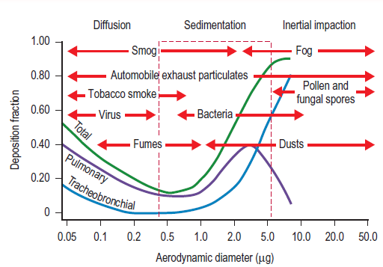

Slide 38
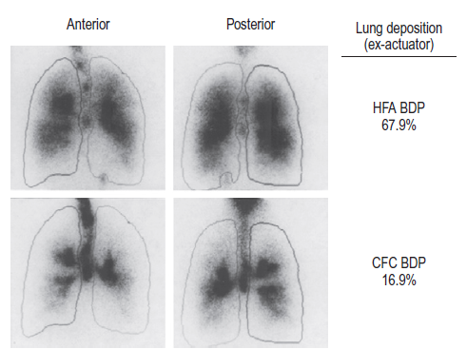
Scintigraphic images of the lungs, anterior and posterior views, in a patient with asthma after inhalation of two different formulations of radiolabeled beclomethasone dipropionate (BDP) pressurized aerosol

Slide 39
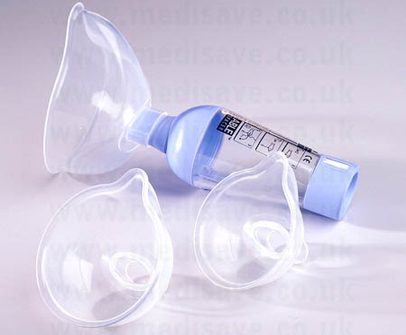

Slide 40
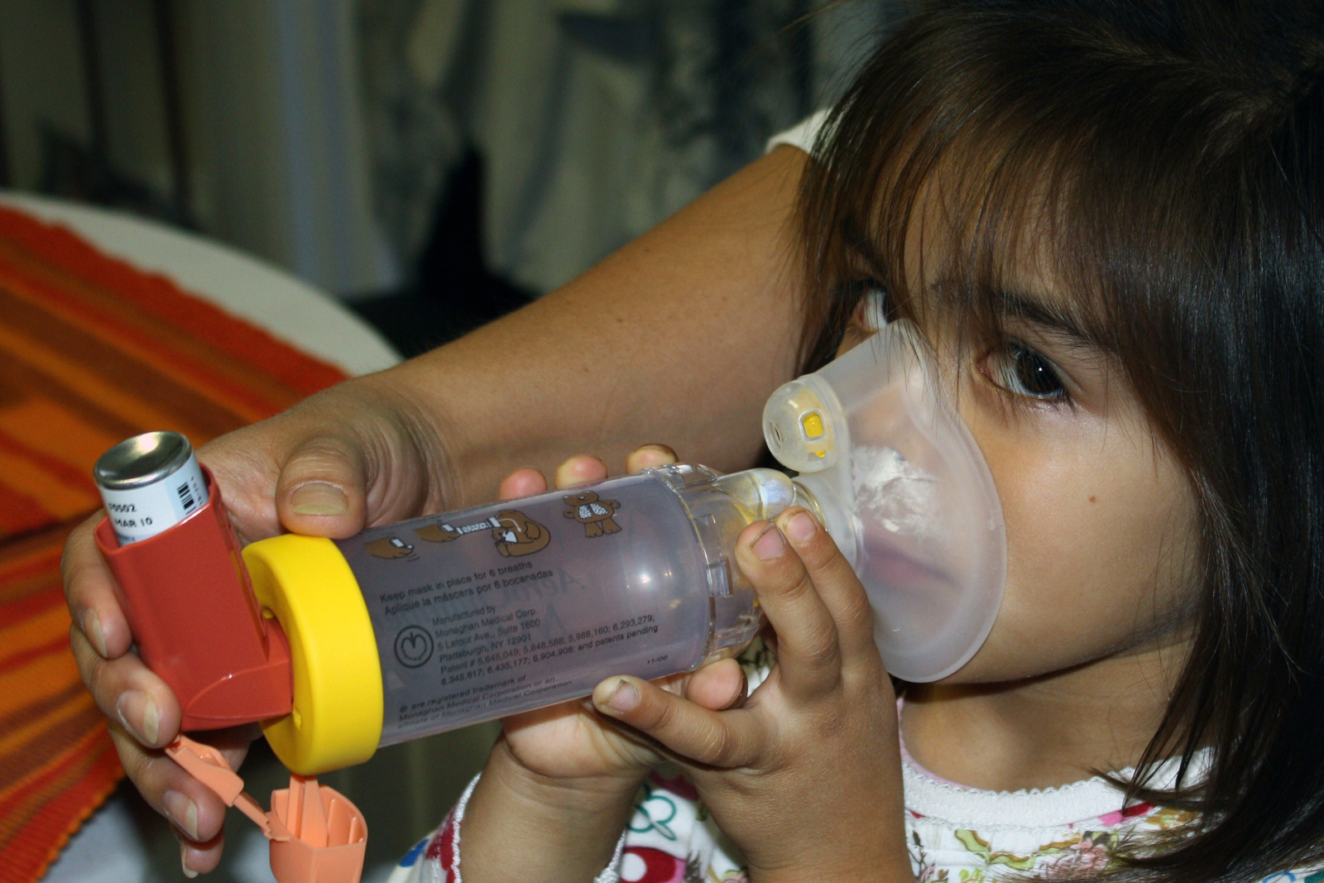

Slide 41
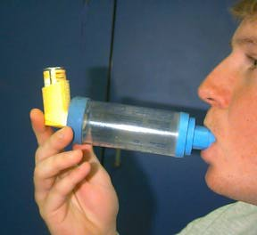

Slide 42
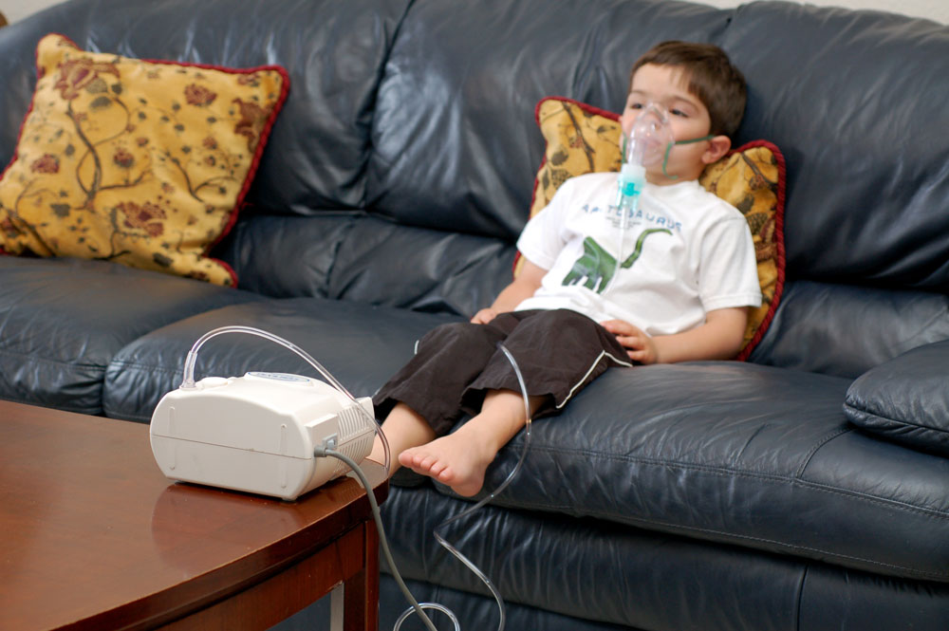

Slide 43
Choices for long-term controller medications
ICSs
Leukotriene modifiers
….
Long-acting β2-agonists (LABAS)
Mast cell stabilizers
Methylxanthines
Biologics (omalizumab)

Slide 44
Immunotherapy
Immunotherapy (SCIT) is the only childhood asthma treatment that has been shown to potentially modify existing allergic sensitization and secondarily reduce allergic asthma in regard to specific exposures.
Allergen immunotherapy has been recommended in patients with stable asthma who are sensitized to that particular allergen if clear association between symptoms and allergen exposure can be established.
Immunotherapy in children has been shown to reduce the incidence of additional allergic sensitization and the subsequent development of both airway hyperresponsiveness and clinically diagnosed asthma.

Slide 45
Environmental control

Slide 46
Aeroallergen sensitization in Outdoor and Indoor Environments
Cockroach
Dust mite
Pet/ Rodent
Mold
Smoking
Viral infections
Day care

Slide 47
Psychosocial factors

Slide 48
More total anxiety disorders
Lower self esteem
Greater functional impairment
Past school problems
Past psychiatric illnesses
Intrafamilial stress.
Depression
Poorly controlled asthma
Increased prevalence
Stress
Asthma

Slide 49
Asthma Education

Slide 50
Several benefits of asthma education have been documented.
Improvement in health status
Self assessment
Use of medications
Prevent or control exacerbations
Reduction in urgent care visits
Hospitalization
Reduction in school absences

Slide 51
A written asthma action plan to asthma self management education significantly decreased hospitalizations and ED visits for asthma in adults.

Slide 53
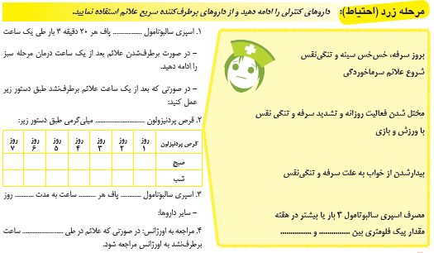

Slide 55
Prognosis

Slide 56
The prognosis for asthma in childhood generally is excellent.
Approximately 20% of children who wheeze during lower respiratory illnesses in the first year of life will no longer wheeze by the age of 3.
By contrast, 15% of wheezing infants will go on to develop persistent wheezing beyond the age of 3 years and should be given a diagnosis of asthma.
The presence of an atopic condition in childhood increased the risk of severe asthma in later life, whereas severe asthma in childhood predicted an increased risk of atopic eczema or allergic rhinitis in later life.

