Slide 2
Patients who have asthma are at risk for complications during and after surgery. These complications include acute bronchoconstriction triggered by intubation, hypoxemia and possible hypercapnia, impaired effectiveness of cough, atelectasis, and respiratory infection, and, if a history of sensitivity is present, reactions to latex exposure or some anesthetic agents.
Asthma and surgery:

Slide 3
Asthma and surgery:
The following actions are recommended to reduce the risk of complications during surgery:
Before surgery, review the level of asthma control, medication use (especially oral systemic corticosteroids within the past 6 months), and pulmonary function.
Provide medications before surgery to improve lung function if lung function is not well controlled. A short course of oral systemic corti costeroids may be necessary.
For patients receiving oral systemic corticosteroids during the 6 months prior to surgery and for selected patients on long-term high-dose ICS, give 100 mg hydrocortisone every 8 hours intravenously during the surgical period, and reduce the dose rapidly within 24 hours after surgery.

Slide 4
Inhaled and parenteral corticosteroids
Patients who have been taking systemic corticosteroids for >2 weeks during the prior 6 months should be considered at risk for adrenal suppression in the setting of severe acute disease, trauma, or major surgery.

Slide 5
Anticholinergic agents
this improves inflammation or worsens inspissation, it certainly decreases airway hyperresponsiveness, an important consideration for the anaesthetist.

Slide 6
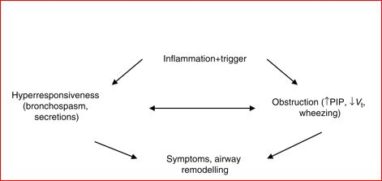

Slide 7
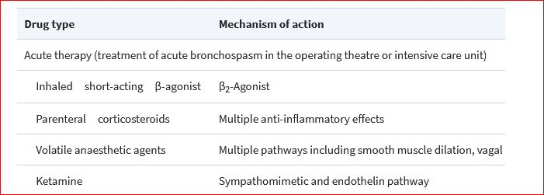

Slide 8
Preoperative evaluation
Preoperative assessment and intervention is the key to successful management of the patient with asthma.
When asthma is well controlled, it probably confers no additional risk for perioperative complications; when it is poorly controlled, it almost always does.
55 Unfortunately, the nature and scope of anaesthetic practice is such that the timeframe for preoperative intervention is all too often short. Moreover, the practitioner can be misled by the variable nature of the disease.
Symptoms may be completely absent before operation with no less a potential for intraoperative bronchospasm. Anti-inflammatory therapy can be suboptimal even when the diagnosis is well established.

