Slide 1
Asthma comorbidity
M.H Eslamian
Allergist and clinical immunologist

Slide 2
comorbidities
rhinitis, sinusitis,
GERD,
Obstructive sleep apnea (OSA),
Hormonal disorders, and
Psychological disturbances

Slide 3
این بیماریها یا ممکن است پاتوفیزیولوژی مشترکی با آسم داسته باشند ویا اینکه روی کنترل آسم و پاسخ دهی آن به درمان تاثیر داشته باشند.

Slide 4
میبایست دقت ویژه ای به تشخیص و درمان این بیماریهای همراه داشت.

Slide 5
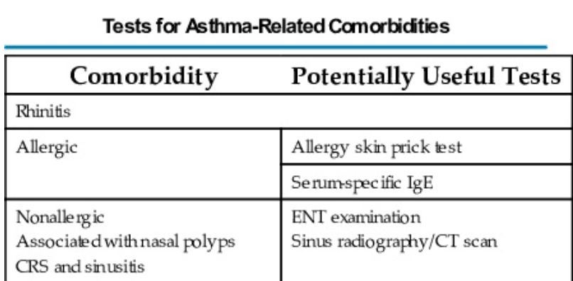

Slide 8
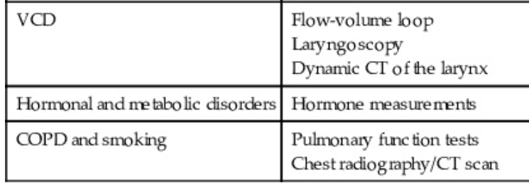

Slide 9
The presence of upper airway comorbidities has been associated with poor outcomes and increased healthcare costs in severe asthma
وجود upper airway comorbidities باعث پیش آگهی بد و هزینه های بالای درمان در آسم های شدید میشود.

Slide 10
CRS with nasal polyps (CRSwNP) has been associated with increased exacerbation frequency .

Slide 11
Rhinosinusitis With or Without Nasal Polyps
More than two-thirds of patients with asthma have chronic nasal symptoms,
evidence of sinusitis on sinus computed tomography (CT) is present in most patients with severe asthma.

Slide 12
Nasal polyps are also found in about 4% of the asthmatic population
and in about 15% of nonatopic patients with asthma

Slide 13
Lower airway inflammation can be observed in patients with nasal polyps, even without evidence of asthma.
The “united airways” hypothesis is based on the concept of “one airway, one disease”—suggesting that upper and lower airway diseases are both manifestations of the same inflammatory disorder .
In this regard, we now have evidence that the lower and upper airways significantly influence each other

Slide 14
Other mechanisms, such as nosepharynx-bronchial reflexes, altered breathing patterns, inhalation of polluted or cold air, and post-nasal drip, may further aggravate the inflammatory disease from upper to lower airways.
However, they did not result in being the primary determinant of comorbidity between CRSwNP and asthma

Slide 15
Chronic rhinosinusitis (CRS) is defined as an inflammatory disorder of the nose and the paranasal sinuses that lasts 12 weeks or longer

Slide 16
CRS consists of two main phenotypes based on endoscopy and computed tomography (CT) findings:
CRSwNP
CRS without nasal polyps (CRSsNP)

Slide 17
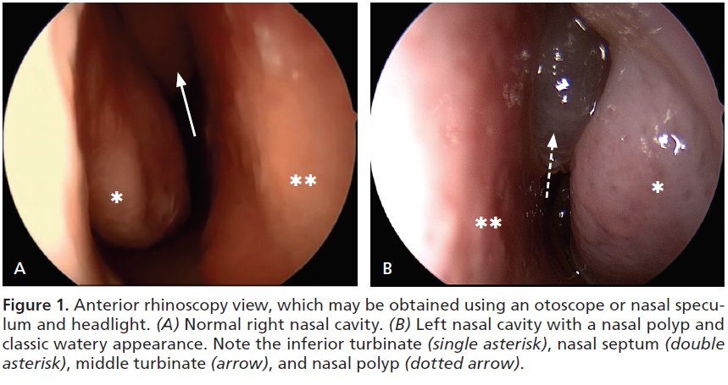

Slide 18
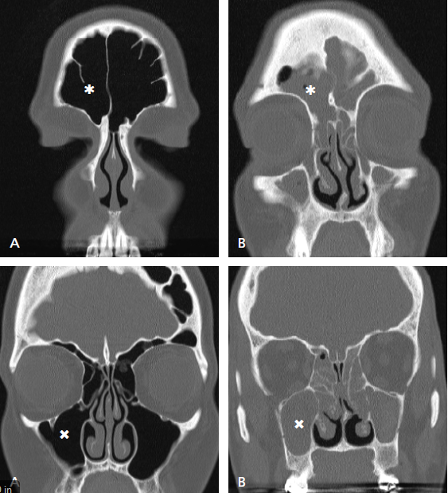

Slide 19
CRSwNP is frequently associated with asthma:
among these patients, from 30% to 70% have asthma

Slide 20
Conversely, patients with asthma have been reported to have CRSwNP, ranging from :
10%-30% in mild asthma
70%-90% in severe asthma

Slide 21
a subset of patients with CRSwNP and asthma who also develop upper and/or lower respiratory tract symptoms following the ingestion of medications that inhibit the cycloygenase-1 enzyme, such as aspirin and other nonsteroidal anti-inflammatory drugs (NSAIDs) . Such patients have aspirin-exacerbated respiratory disease (AERD).
This entity is the most serious and recurrent clinical form of NP associated with severe asthma

Slide 22
Novel therapeutic approaches with biologics

Slide 25
Allergic rhinitis
The AR is the most common allergic disease in the world.
AR is an important comorbidity in asthma

Slide 26
Allergen immunotherapy
beneficial in the management of AR and can reduce or stop development of asthma in allergy to certain inhalants (dust, grass, tree, and ragweed)

Slide 27
Gastroesophageal Reflux Disease
GERD-related symptoms are also more common in patients with asthma than in the general population, with an estimated prevalence varying from 30% to 90%.

Slide 28
GERD can affect asthma through its direct effects on airway function or via aspiration-induced inflammation
However, bronchoconstriction can also induce gastroesophageal reflux.

Slide 29
The benefits of treatment of GERD on asthma outcomes are variable.
In general, no benefit is seen on asthma in treating asymptomatic GERD

Slide 30
For symptomatic patients, a trial of treatment can be attempted, especially if nighttime symptoms are present, because a few studies have shown a small benefit in asthma outcome with proton-pump therapy in this population

Slide 31
با تشکر از توجه شما

