Slide 1
Biologic therapy in Asthma
Dr Sabah Hasani,MD
Pulmonologist
Notes:
This presentation demonstrates the new capabilities of PowerPoint and it is best viewed in Slide Show. These slides are designed to give you great ideas for the presentations you’ll create in PowerPoint 2010!
For more sample templates, click the File tab, and then on the New tab, click Sample Templates.

Slide 2
Sever Asthma
1
Design, organize, and collaborate

Slide 3
Definition
asthma that requires treatment with high dose inhaled corticosteroids plus a second controller and/or systemic corticosteroids to prevent it from becoming ‘‘uncontrolled’’ or that remains ‘‘uncontrolled’’ despite this therapy’.
Patients to have had at least two attacks in the previous year despite regular use of high dose inhaled corticosteroid (ICS)plus another controller

Slide 4
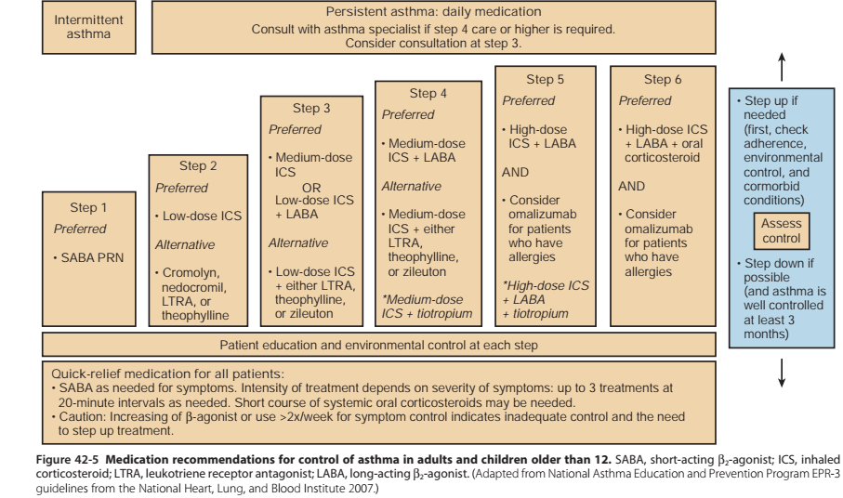

Slide 5
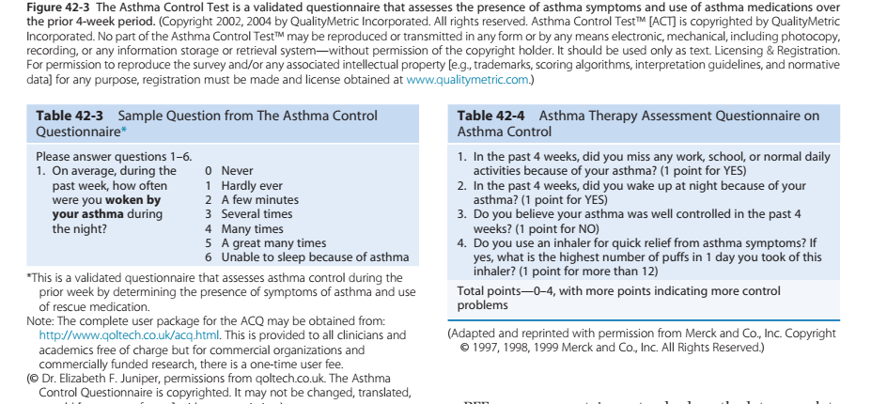
OUT COMES

Slide 6
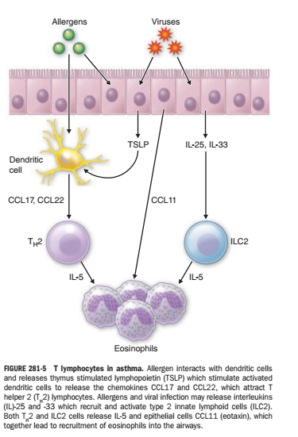
Cytokine in Asthma
The T H2 cytokines
IL-4, IL-5, IL-9, and IL-13 mediate allergic inflammation.
proinflammatory cytokines such as TNF-α and IL-1β amplify the inflammatory response and play a role in more severe disease.
TSLP is an upstream cytokine released from epithelial cells of asthmatics

Slide 7
Should a monoclonal anti-IL5 antibody be used in adults with Severe asthma?
Interleukin 5 (IL-5) is a principal cytokine driving eosinophilic inflammation
Monoclonal antibodies that target IL-5 (mepolizumab, reslizumab) or its receptor IL-5Rα(benralizumab)
approved by the U.S. Federal Drug Administration (FDA)/European Medicines Agency (EMA).

Slide 8
Mepolizumab
Dosage:
300 mg SC q4wk (ie, as 3 separate 100-mg SC injections)
Prescription Criteria
Severe eosinophilic asthma
blood eosinophil count >300 cells/mm3in the 12 months prior to screening
>150 cells/mm3during screening
oral corticosteroid [OCS]optimization period.

Slide 9
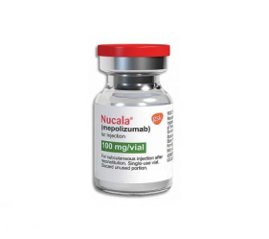

Slide 10
OUTCOMES
50% reduction in the rate of any exacerbation
64% reduction in exacerbations requiring emergency department (ED) visit or hospitalization .
An absolute 0.43-point decrease (i.e. improvement) in ACQ-5
and an absolute 7.14 decrease (i.e.improvement) in the SGRQ scale
50% median reduction in the dose of maintenance oral corticosteroids(OCS)

Slide 11
Reslizumab
Dosage:
3 mg/kg IV q4wk infused IV over 20-30 minutes
inclusion criteria:
Blood eosinophils >400 cells/mm3
sputum eosinophil >3%

Slide 12
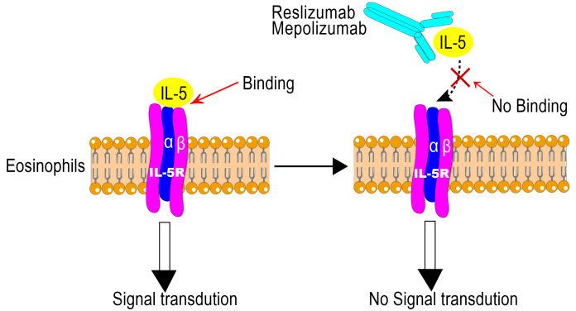
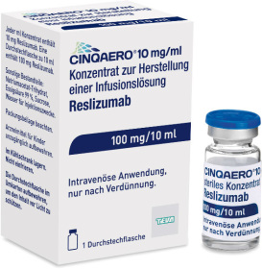

Slide 13
OUTCOME
A 54% reduction in any exacerbation
33% reduction in exacerbations requiring ED visits or hospitalizations
a 60% reduction in the risk of having ≥ 1 exacerbation
0.26-point decrease (i.e. improvement) in ACQ-7
0.28-point increase (i.e. improvement) in AQLQ scale
Notes:
S

Slide 14
Benralizumab
DOSAGE:
30 mg SC q4weeks for the first 3 doses, THEN q8weeks thereafter

Slide 15
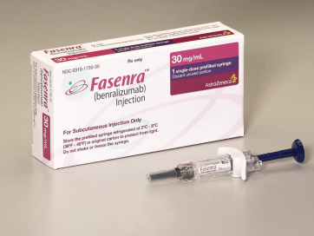
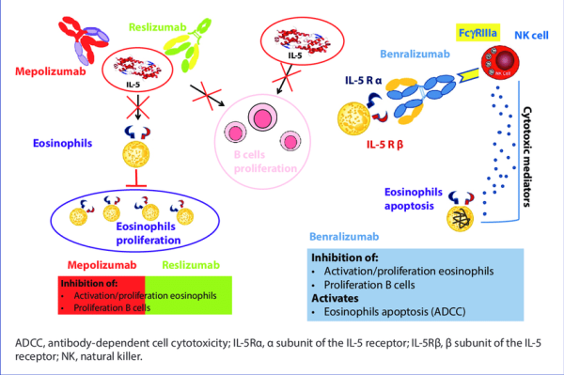

Slide 16
Benralizumab
a 42% reduction in the rate of any exacerbation
a 38% reduction in the number of patients with ≥1 exacerbation
Absolute 0.29-point decrease in ACQ-6
An absolute 0.32-point increase (i.e. improvement) in AQLQ scale

Slide 17
Adverse effects
0.93 for mepolizumab
0.88 for reslizumab
0.96 for benralizumab

Slide 18
Anti-IL5 strategy
reduces exacerbations in patients with severe eosinophilic asthma.
effective in reducing OCS dose in corticosteroid- dependent asthma.
The effects on asthma control, quality of life and FEV 1 are modest for all drugs

Slide 19
Should a measurement of a specific biomarker be used to guide initiation of treatment with a monoclonal anti-IL5 or IL 5Rα antibody in adults ?
exhaled NO,
peripheral or sputum eosinophils,
serum periostin

Slide 20
Blood eosinophils can be measured
higher levels of blood eosinophil counts benefit more from anti-IL5 strategies,
a specific level of blood eosinophils is an absolute response threshold
greater than or equal to 150/μL for mepolizumab
≥300/μL for benralizumab
≥400/μLfor reslizumab

Slide 21
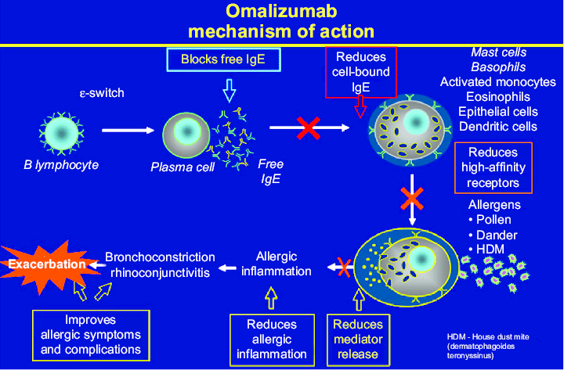
Omalizumab

Slide 22
Indication:
IgE ≥30U
A minimum omalizumab dose of 0.008 mg/kg/IgE (IU/mL) every 2 weeks or a minimum of 0.016 mg/kg/IgE (IU/mL) every 4 weeks.

Slide 23
HIGH EOSINOPHIL LEVEL
significant improvements in exacerbation rates
greater change in FEV1%predicted at 24 weeks
a significantly longer time to first asthma exacerbation
High FeNO level (19.5 ppb or more)
a significant relative reduction of exacerbation rates with at 48 weeks follow
High periostin(⩾50 ng·mL−1)
No differences in the relative reduction of exacerbation rates at 48 weeks or FEV1

Slide 24
a baseline blood eosinophilcount⩾260 μL−1
is associated with greater improvements in FEV1, and a decreased rate of exacerbations and longer time to first exacerbation
the presence of FENO⩾19.5 ppb
is associated with improvements in AQLQ, reduced exacerbation rate and longer time to first exacerbation
Periostin <50 ng·mL−1
was associated with improvements in AQLQ
patients with eosinophil or FENO values below the proposed cut-offs can still benefit from omalizumab.

Slide 25
Should a monoclonal anti-IL-4Rα be used in adults and children with severe asthma?
Dupilumab is a fully human monoclonal antibody directed against the α subunit of IL-4 receptor.
blocks signalling of two key type 2 cytokines: IL-4 and IL-13.
200 or 300 mg of the drug administered S.C. every 2 or 4 weeks for 24 weeks
Secondary end-points included change in FEV1% pred, ACQ and AQLQ,
reduction in OCS dose required to maintain asthma control. Secondary end-points included proportion of patients with at least 50% reduction in OCS dose
the greatest treatment response in patients with FENO⩾25 ppb and blood eosinophils⩾150 μL−1.

Slide 26
